Slide 1
IBM University Engagement Project Submission
“Exploring the Power of Agentic AI with IBM Cloud and Orchestrate”

Slide 2

Project Tile – Agentic AI for Mental Health Awareness & Suicide Prevention
Domain of Project –Healthcare
Student Name | Recent Passport Photo | Email ID | Mobile number [WhatsApp]
Priyanka bind |  | pbind6636@gmail.com | 9270355337

Slide 3
Problem Statement -
Problem Statement : Agentic AI for Mental Health Awareness & Suicide Prevention
The Challenge
Mental health issues such as stress, anxiety, depression, and suicidal thoughts are increasing worldwide. Many people hesitate to seek help due to stigma, lack of awareness, and limited access to professional support. Traditional mental health systems often provide delayed assistance, making early detection and timely intervention difficult.
The Objective
Build an AI-powered Mental Health Awareness & Suicide Prevention Agent that provides empathetic support, promotes mental health awareness, detects emotional distress at an early stage, and connects users with trusted mental health resources. The solution should:
Promote Mental Health Awareness – Provide reliable information on stress management, mindfulness, emotional well-being, and self-care.
Enable Early Risk Detection (RAG) – Analyze conversations or journal entries to identify signs of stress, anxiety, depression, or suicidal thoughts using trusted knowledge sources.
Provide Empathetic Support – Offer supportive, non-judgmental conversations and personalized coping strategies.
Predict & Prevent Risks – Monitor emotional patterns, detect high-risk situations, and recommend preventive actions.
Connect to Professional Help – Guide users to verified helplines, counselors, psychologists, or emergency services whenever required.

Slide 4
Proposed Solution -
Proposed Solution: AI-Powered Mental Health Awareness & Suicide Prevention Agent
The proposed solution is a Multi-Agent AI-powered Mental Health Awareness & Suicide Prevention Agent developed using Lang Flow, IBM watsonx.ai, IBM Granite Models, and RAG (Retrieval-Augmented Generation). The system provides emotional support, mental health awareness, early risk detection, and timely guidance in a safe and empathetic manner.
The solution uses a RAG pipeline to retrieve trusted mental health information from reliable sources such as WHO, NIMH, and government mental health resources. This ensures that users receive accurate, evidence-based, and safe responses.
The system consists of four specialized agents:
Mental Health Knowledge Agent – Retrieves trusted information on stress, anxiety, depression, mindfulness, and self-care practices using RAG.
Emotional Support Agent – Provides empathetic conversations, emotional encouragement, and personalized coping strategies.
Risk Detection Agent – Analyzes user conversations or journal entries to identify signs of emotional distress or suicidal risk and generates early alerts.
Crisis Support Agent – Recommends verified helplines, counselors, emergency contacts, and community support resources during high-risk situations.

Slide 5
The solution also includes a user-friendly dashboard that tracks mood history, stress levels, emotional trends, and self-care progress through interactive visualizations. LangFlow is used to orchestrate the multi-agent workflow, IBM watsonx.ai manages model deployment and AI governance, while IBM Granite Models provide reasoning, summarization, empathy, and personalized responses. Overall, this solution acts as an intelligent, proactive, and compassionate mental health companion that promotes awareness, supports emotional well-being, detects risks early, and encourages users to seek professional help whenever needed..

Slide 6
Technology Used
Langflow platform -For designing and orchestrating multi-agent workflows visually.
IBM Granite model - for eg – ibm-granite-3-2-8b – For natural language understanding, reasoning, and personalization.
IBM Cloud – It provides the infrastructure to build, deploy, and scale the Nutrition Agent efficiently. IBM Cloud enables a reliable, secure, and scalable environment for deploying the Nutrition Agent.
RAG– RAG to fetch real data first, then generate intelligent answers, making the Nutrition Agent more trustworthy and effective.
IBM Watsonx.ai - For model deployment, embeddings, prompt engineering, and AI governance.
Vector Database (FAISS/Chroma) – Stores and retrieves mental health knowledge efficiently.

Slide 7
LangFlow Components Used -
Chat Input – Accepts user messages, emotions, or mental health-related questions.
IBM watsonx AI Agent – Processes the user input and coordinates the AI workflow using IBM Granite Models.
IBM Granite Model (Granite-4.0-8B-Instruct) – Generates empathetic, personalized, and context-aware responses.
RAG Component – Retrieves trusted mental health information from verified sources before generating answers.
Prompt Template – Structures prompts to ensure safe, supportive, and accurate AI responses.
Chat Output – Displays emotional support, coping strategies, mental health guidance, and crisis recommendations.
File Component – Stores and retrieves mental health resources, FAQs, and knowledge documents.

Slide 8
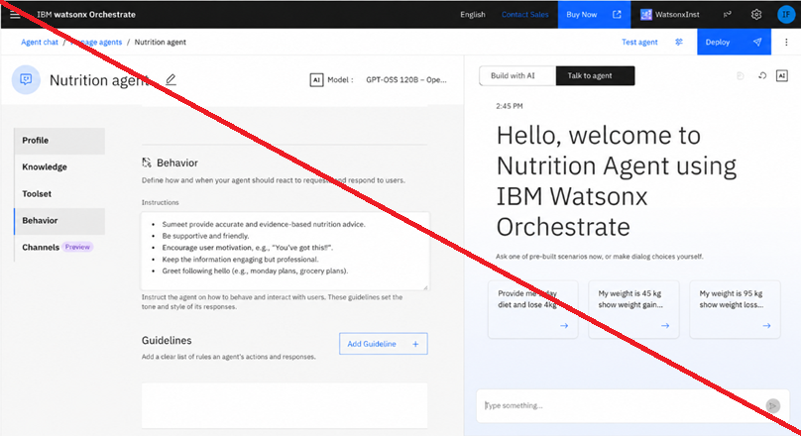
Agent Instructions Screenshot-

Slide 9
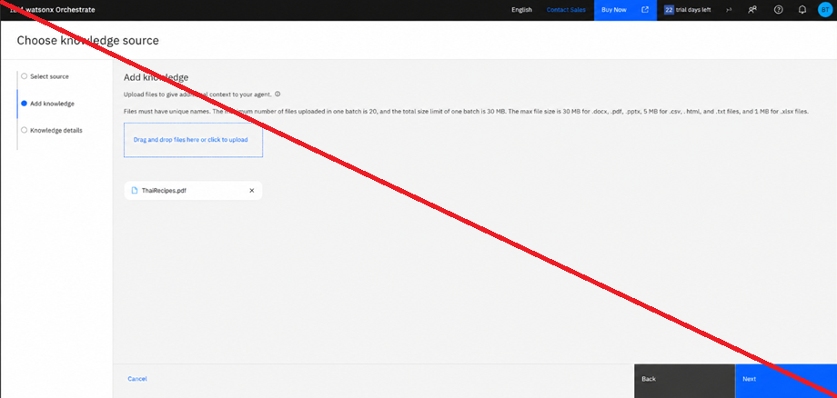
Document Uploaded Screenshot (If applicable)-

Slide 10
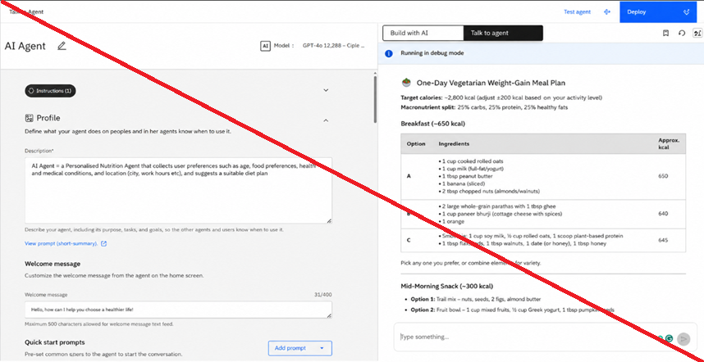
Prompt with output Screenshot:
-Use different slides for multiple screenshots

Slide 11
Other Applicable Screenshots:
- Put multiple screenshots for multiple prompts and outputs
All the content screenshots should be clearly visible

Slide 12

Orchestrate architecture blueprint

Slide 13

Role of Agentic AI in the solution
Agentic AI enables the Mental Health Awareness & Suicide Prevention Agent to function as an intelligent, proactive, and empathetic assistant rather than a simple chatbot. Using IBM watsonx.ai and IBM Granite Models, it coordinates multiple specialized AI agents to provide personalized mental health support.
Each agent performs a specific task, such as retrieving trusted mental health information, offering emotional support, detecting signs of stress, anxiety, depression, or suicidal risk, and recommending appropriate coping strategies or professional help. These agents work together to deliver accurate, context-aware, and timely responses.
Agentic AI understands the user's emotional state, adapts its guidance based on conversations, and continuously improves recommendations. In high-risk situations, it encourages users to seek professional assistance and provides verified crisis support resources.
Overall, Agentic AI makes the solution intelligent, personalized, proactive, and reliable, acting as a compassionate digital mental health companion that promotes awareness, emotional well-being, and early intervention..

Slide 14
Novelty and Uniqueness
Multi-Agent AI Architecture – Uses multiple specialized AI agents that work together to provide accurate and personalized mental health support.
RAG-Based Trusted Information – Retrieves information from reliable mental health resources, ensuring safe and evidence-based responses.
Early Risk Detection – Identifies signs of stress, anxiety, depression, and potential suicidal thoughts through conversation analysis.
Personalized Emotional Support – Delivers empathetic guidance and coping strategies based on each user's emotional condition.
Real-Time Mood Tracking – Monitors mood patterns and provides timely wellness recommendations.
Crisis Support Integration – Suggests verified helplines, counselors, and emergency resources during high-risk situations.
Secure and Scalable Solution – Built using IBM watsonx.ai, IBM Granite Models, and LangFlow, making it reliable, scalable, and enterprise-ready.

Slide 15
Git Hub Link
Please create public github repository (Enable Add README button while creating repository) with format –
Please test and Paste the working Github URL –
Make sure you have Uploaded following three files into your github repository 1) app.json file , 2) yourproblemstatement.pdf file 3) your projectpresntation.pptx file 4)any other files
·
·
·

Slide 16
Future Scope
1. Wearable Device Integration
The system can be integrated with smartwatches and fitness bands to monitor heart rate, sleep patterns, and stress levels. This will help provide more accurate and personalized mental health support.
2. Voice Assistant & Multilingual Support
The solution can support voice interaction and multiple languages, making mental health assistance more accessible to users from different regions.
3. AI-Based Mood Prediction
Future versions can analyze user behavior and mood history to predict emotional changes and provide early preventive recommendations.
4. Professional Counseling Integration
The agent can be connected with certified psychologists, counselors, and mental health helplines, allowing users to easily access professional support whenever needed.
·
·
·

Slide 17
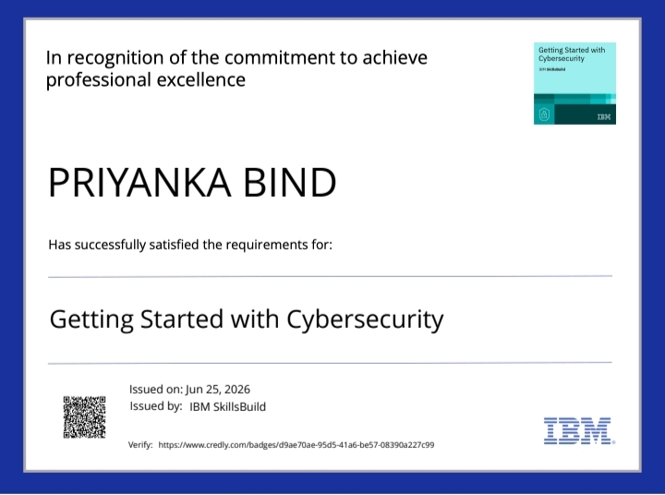
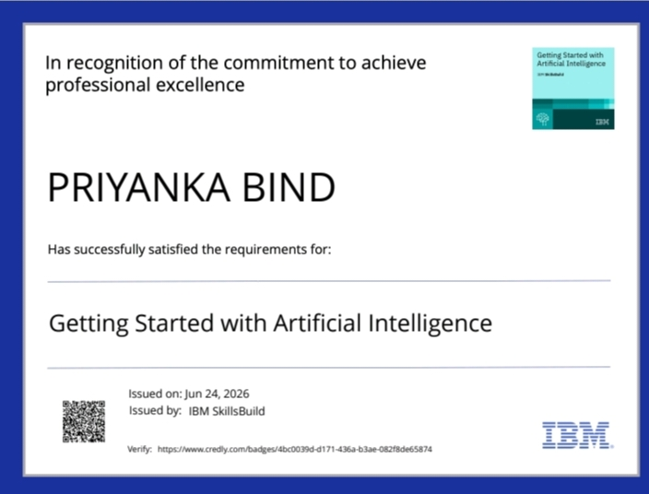
Certificates Earned:

Slide 18
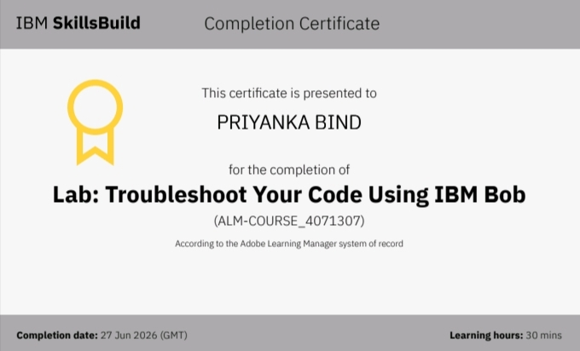

Certificates Earned:​

Slide 19


